Slide 1

BCSE497J Project-I B.Tech Data Science & Engineering (Review 2) Wearable Periorbital Multi-Sensor System for Early Detection of Diabetic Neuro-Retinal Changes
Team members:
Shlok Goenka (23BDS0316)
Aryan Hundia (23BCI0020)
Faculty guide :
Dr. Jayashree J

Slide 2

Approval Mail From Guide
Get the approval for the following points from your guide through mail before 01-09-2026.(sample attached below)

Slide 3
Aim
To design and develop a wearable periorbital multi-sensor system that enables early, non-invasive and continuous detection of diabetic neuro-retinal changes by simultaneously monitoring retinopathy and neuropathy biomarkers in a single spectacle-frame device.
The system integrates four complementary sensing modalities (infrared pupillography, periorbital thermography, bioimpedance spectroscopy and photoplethysmography) with an edge-AI processor to compute a unified Neuro-Retinal Deterioration Index (NRDI) correlated with continuous glucose monitoring data.

Slide 4
Abstract
Diabetic patients with 10+ years of disease develop parallel microvascular complications, namely diabetic retinopathy (DR) and diabetic peripheral neuropathy (DPN), yet current screening treats these as isolated conditions requiring separate specialists, equipment and clinical visits.
This work proposes a spectacle-frame wearable embedding four sensor modalities that continuously acquire periorbital physiological signals correlated with both DR and DPN progression: pupillary dynamics (autonomic neuropathy), periorbital skin temperature (retinal microvascular perfusion), tissue bioimpedance (macular edema) and temporal-artery pulse (vascular stiffness and cardiac autonomic neuropathy).
An edge-AI fusion engine computes a unified Neuro-Retinal Deterioration Index (NRDI), enabling detection of subclinical deterioration 6 to 18 months before conventional annual screening, at an estimated hardware cost under Rs 8,000, making it deployable at rural primary health centres.

Slide 5
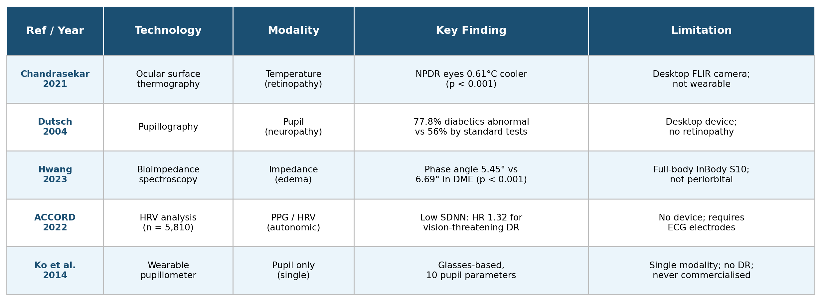

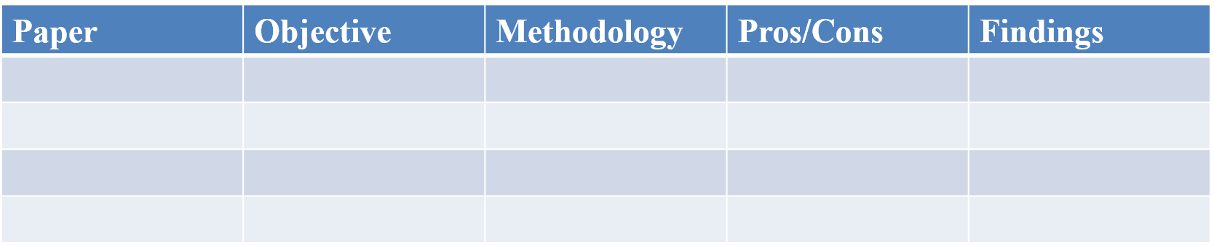
Literature Review

Slide 6
Research Gap
Isolated screening: all existing devices (IDx-DR, Remidio, RETeval) detect retinopathy OR neuropathy, never both in one device.
Fundus-camera dependency: every DR screening method requires a fundus camera (Rs 2 to 15 lakh), unavailable at rural PHCs.
No wearable periorbital system: searches across Google Patents, IPAIRS and PubMed (2020 to 2025) returned ZERO wearable devices combining periorbital pupillography, thermography, bioimpedance and PPG.
Periodic vs. continuous: annual screening misses between-visit progression; nearly 50% of patients skip annual exams.
Closest prior art (Ko et al. 2014, Taiwan pupillometer): single modality, monocular, clinic-based, no retinopathy assessment, no CGM, and never commercialised.

Slide 7

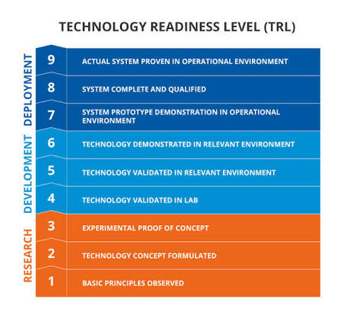
Objectives
Design a spectacle-frame multi-sensor hardware system integrating IR pupillography, thermography, bioimpedance and PPG on a single edge-AI platform (ESP32-S3).
Validate each sensor modality against clinical ground truth on diabetic vs. control cohorts, establishing statistical separation (target p < 0.05).
Develop the Neuro-Retinal Deterioration Index (NRDI) fusion algorithm correlating sensor data with CGM-derived glycemic variability.
Demonstrate early-detection capability and file an Indian patent for the novel apparatus before publication.
Identified SDGs: SDG 3 (Good Health & Well-being), SDG 9 (Industry, Innovation & Infrastructure), SDG 10 (Reduced Inequalities)
Current TRL: 2 to 4
Target Outcomes: Indian Patent (Form 2) + 2 Scopus-indexed papers (Hardware + Dataset/AI) + Product prototype

Slide 8
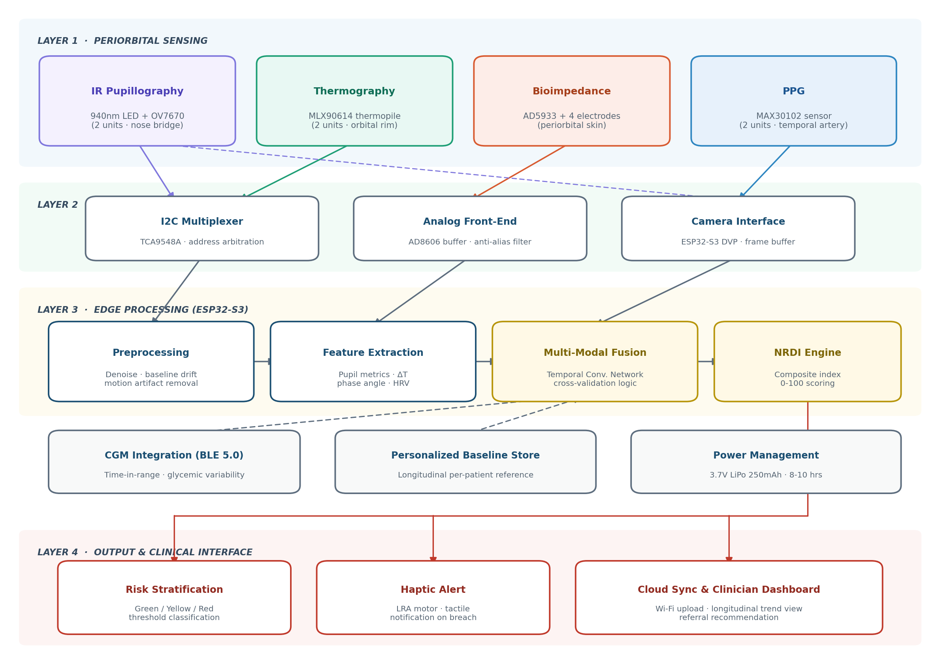
Framework/Architecture/Block Diagram
Four-layer architecture. Sensing layer captures four modalities across the spectacle frame; acquisition layer performs bus arbitration, analog conditioning and camera framing; edge processing layer runs preprocessing, feature extraction and fusion on the ESP32-S3; output layer handles risk stratification, haptic alerting and cloud sync.
Bus design. Two thermopiles and two PPG sensors share an I2C bus through a TCA9548A multiplexer, since each device family presents a fixed address that would otherwise collide. Bioimpedance electrodes route through an AD8606 buffer before the AD5933 analyser.
Cross-validation logic. The fusion stage evaluates concordance across the four independent signal sources, which suppresses false positives that single-modality devices cannot distinguish.

Slide 9
Functional Requirements
Multi-modal acquisition: sample pupillary video at 30 fps, periorbital temperature at 0.02 degree C resolution, tissue impedance across a 1 kHz to 100 kHz sweep, and PPG waveforms at 100 Hz.
Bilateral measurement: acquire from both left and right periorbital regions to compute inter-ocular asymmetry.
Signal preprocessing: remove baseline drift, power-line interference and motion artefacts prior to feature extraction.
Feature extraction: derive pupillary dynamics, thermal differentials, impedance phase angle and HRV indices.
Glycemic ingestion: pair with a CGM over BLE 5.0 and retrieve time-in-range and variability metrics.
Index computation: fuse features with glycemic context to compute NRDI on a 0 to 100 scale within 90 seconds.
Risk stratification and alerting: classify into three levels and activate haptic notification on threshold breach.

Slide 10
Modules
Module 1: Periorbital Sensing. Ten sensing units across four modalities mounted on the spectacle frame (2 IR LED + camera pairs, 2 thermopiles, 4 electrodes, 2 PPG sensors).
Module 2: Signal Acquisition. TCA9548A I2C multiplexer, AD8606 analog front-end and the ESP32-S3 parallel camera interface.
Module 3: Preprocessing. Denoising, baseline drift correction and motion artefact rejection on the embedded target.
Module 4: Feature Extraction. Pupil metrics, bilateral thermal delta, impedance phase angle and HRV indices (SDNN, RMSSD).
Module 5: NRDI Fusion Engine. Temporal convolutional network performing cross-modality validation against a personalised baseline.
Module 6: Output and Sync. Three-level risk classification, LRA haptic alerting and Wi-Fi upload to a clinician dashboard.

Slide 11
Experiments and Results
Experimental setup. Since hardware fabrication is in progress, validation cohorts were constructed from published clinical parameter distributions (means, standard deviations and reported p-values) drawn from PubMed-indexed studies for each of the four modalities.
Evaluation protocol. Each modality is first evaluated as a single-sensor baseline classifier, then the four are combined through the NRDI fusion stage. Discrimination between diabetic and control cohorts is measured by AUROC and two-sample significance testing.
Literature-derived effect sizes. Thermography 0.61 degree C separation (p < 0.001); pupillography detects 77.8% vs 56% by standard tests; bioimpedance phase angle 5.45 vs 6.69 degrees (p < 0.001); low SDNN carries HR 1.32 for vision-threatening DR.
Status and next step. Fusion model development is underway; the target outcome is demonstrating that the composite NRDI achieves higher discrimination than any single constituent modality at p < 0.05, followed by pilot data collection on the assembled prototype.

Slide 12
Conclusion
A wearable periorbital multi-sensor system has been designed that monitors indicators of diabetic retinopathy and neuropathy simultaneously from a single spectacle-frame platform, addressing a gap that no existing patent, product or funded project currently fills.
The periorbital region is established as the only external site where the relevant autonomic nerves, retinal blood supply, venous drainage and systemic vasculature converge, which justifies the sensor placement geometry.
Cross-validation across four independent modalities suppresses environmental false positives that single-sensor devices cannot resolve, forming the core inventive contribution expressed as the NRDI.
Future work: complete PCB fabrication and prototype assembly, obtain institutional ethics clearance, collect pilot data from diabetic and control cohorts, and file the Indian patent before publication.

Slide 13
References
[1] R. Chandrasekar et al., "Assessment of ocular surface temperature in diabetic retinopathy," Exp. Eye Res., vol. 211, 2021. (PMID: 34464609)
[2] M. Dutsch et al., "Pupillography refines the diagnosis of diabetic autonomic neuropathy," J. Neurol. Sci., vol. 222, pp. 75-81, 2004. (PMID: 15240199)
[3] S. Hwang et al., "Bioimpedance phase angle and diabetic macular edema," J. Clin. Med., vol. 12, no. 20, 2023. (PMC10607216)
[4] ACCORD Study Group, "Heart rate variability and incident retinopathy in type 2 diabetes," Diabetes Care, vol. 45, 2022. (PMID: 35467041)
[5] Y. F. Ko et al., "Design of a wearable pupillometer for diabetic autonomic neuropathy," Appl. Opt., vol. 53, no. 29, pp. H27-H34, 2014.
[6] R. Raman et al., "Prevalence of diabetic retinopathy in India: SMART India study," Lancet Glob. Health, vol. 10, no. 12, pp. e1764-e1773, 2022.

